Slide 1
Introduction to linear programming (LP) using GAMS and Pyomo

Slide 2
Agenda
Review linear programming
Example 1 (advertising industry)
Coding in GAMS
Coding in Python
Example 2 (staff allocation)
Coding in GAMS
Coding in Python
Example 3 (revisiting Example 1)
Coding in GAMS
Coding in Python

Slide 3


Review linear programming
Linear programming (LP)
f, h, and g are all linear
x is all continuous variable
$$\min{f(x)}$$
subject to
$$h\left(x\right)=0$$
$$g\left(x\right)≤0$$
$$x∈R^{n}$$

Slide 4
Example 1*
Dorian Auto manufactures luxury cars and trucks. The company believes that its most likely customers are high-income women and men. To reach these groups, Dorian Auto has embarked on an ambitious TV advertising campaign and has decided to purchase 1-minute commercial spots on two types of programs: comedy shows and football games. Each comedy commercial is seen by 7 million high-income women and 2 million high-income men. Each football commercial is seen by 2 million high-income women and 12 million high-income men. A 1-minute comedy ad costs $50,000, and a 1-minute football ad costs $100,000. Dorian would like the commercials to be seen by at least 28 million high-income women and 24 million high-income men. Use linear programming to determine how Dorian Auto can meet its advertising requirements at minimum cost.

Slide 5
Extracting information from problem statement
Dorian Auto manufactures luxury cars and trucks. The company believes that its most likely customers are high-income women and men. To reach these groups, Dorian Auto has embarked on an ambitious TV advertising campaign and has decided to purchase 1-minute commercial spots on two types of programs: comedy shows and football games. Each comedy commercial is seen by 7 million high-income women and 2 million high-income men. Each football commercial is seen by 2 million high-income women and 12 million high-income men. A 1-minute comedy ad costs $50,000, and a 1-minute football ad costs $100,000. Dorian would like the commercials to be seen by at least 28 million high-income women and 24 million high-income men. Use linear programming to determine how Dorian Auto can meet its advertising requirements at minimum cost.
Objective
Variable
Constraint

Slide 6
Organizing information - variables
How many comedy, and football ads must be purchased
x₁ : number of 1-minute comedy ads purchased
x₂ : number of 1-minute football ads purchased

Slide 7
Organizing information: objective
Minimize: total advertising cost (in thousands of dollars)
Total advertising cost = cost of comedy ads + cost of football ads
= (cost per comedy ad)*(# comedy ads purchased) +
(cost per football ad)*(# football ads purchased)
=
Objective function:
$$50x_{1}+100x_{2}$$
$$z=50x_{1}+100x_{2}$$

Slide 8

Organizing information: constraints (1)
Constraint 1: Commercials must reach at least 28 million high income women
Eq1: (HIW per comedy ad) x (# comedy ads purchased) +
(HIW per football ad) x (# football ads purchased) >= 28
$$7x_{1}+2x_{2} ≥28 (eq1)$$

Slide 9

Organizing information: constraints (2)
Constraint 2: Commercials must reach at least 24 million high income men
Eq2: (HIM per comedy ad) x (# comedy ads purchased) +
(HIM per football ad) x (# football ads purchased) >= 24
$$2x_{1}+12x_{2} ≥24 (eq2)$$

Slide 10


Assembling optimization model
$$\min{z}=50x_{1}+100x_{2}$$
subject to
$$7x_{1}+2x_{2} ≥28 (eq1)$$
$$2x_{1}+12x_{2} ≥24 (eq2)$$

Slide 11
Example 2*
A post office requires different numbers of full-time employees on different days of the week. The number of full-time employees required on each day is given in Table 4. Union rules state that each full-time employee must work five consecutive days and then receive two days off. For example, an employee who works Monday to Friday must be off on Saturday and Sunday. The post office wants to meet its daily requirements using only fulltime employees. Formulate an LP that the post office can use to minimize the number of full-time employees who must be hired.

Slide 12
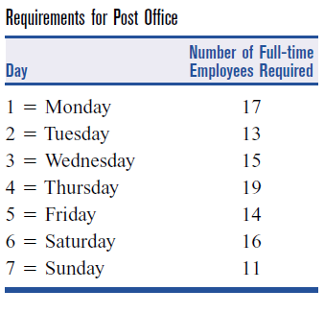
Extracting information from problem statement
A post office requires different numbers of full-time employees on different days of the week. The number of full-time employees required on each day is given in Table 4. Union rules state that each full-time employee must work five consecutive days and then receive two days off. For example, an employee who works Monday to Friday must be off on Saturday and Sunday. The post office wants to meet its daily requirements using only fulltime employees. Formulate an LP that the post office can use to minimize the number of full-time employees who must be hired.
Objective
Variable (?)
Constraint

Slide 13







(incorrect)
Organizing information – variables
Let x_{i} be the number of employees working on day i (i = 1: Monday, i = 2: Tuesday,…)
Objective function:
Then, the constraints would be:
Flaw 1:
Objective function is not correctly defined
Flaw 2:
Interdependency between variables (x_{i}) is not captured
$$\min{z}=x_{1}+x_{2}+x_{3}+x_{4}+x_{5}+x_{6}+x_{7}$$
$$x_{1} ≥17$$
$$x_{4} ≥19$$
$$x_{2} ≥13$$
$$x_{5} ≥14$$
$$x_{7} ≥11$$
$$x_{3} ≥15$$
$$x_{6} ≥16$$

Slide 14
Organizing information – variables (correct) and objective
Let x_{i} be the number of employees beginning work on day i (i = 1: Monday, i = 2: Tuesday,…)
Objective function:
$$\min{z}=x_{1}+x_{2}+x_{3}+x_{4}+x_{5}+x_{6}+x_{7}$$

Slide 15

Organizing information – constraints (1)
Constraint 1: at least 17 full-time employees are required on Monday
(since employees beginning work on Monday, Thursday, Friday, Saturday, and Sunday would also work on Monday, i.e., five consecutive workdays + 2 consecutive rest days requirement fulfilled)
$$x_{1}+x_{4}+x_{5}+x_{6}+x_{7} ≥17 (eq1)$$

Slide 16




Organizing information – constraints (2)
$$x_{1}+x_{4}+x_{5}+x_{6}+x_{7} ≥17 (eq1)$$
$$x_{1}+x_{2}+x_{5}+x_{6}+x_{7} ≥13 (eq2)$$
$$x_{1}+x_{2}+x_{3}+x_{6}+x_{7} ≥15 (eq3)$$
$$x_{1}+x_{2}+x_{3}+x_{4}+x_{7} ≥19 (eq4)$$
$$x_{1}+x_{2}+x_{3}+x_{4}+x_{5} ≥14 (eq5)$$
$$x_{2}+x_{3}+x_{4}+x_{5}+x_{6} ≥16 (eq6)$$
$$x_{3}+x_{4}+x_{5}+x_{6}+x_{7} ≥11 (eq7)$$

Slide 17
Assembling optimization model
$$\min{z}=x_{1}+x_{2}+x_{3}+x_{4}+x_{5}+x_{6}+x_{7}$$
subject to
$$x_{1}+x_{4}+x_{5}+x_{6}+x_{7} ≥17 (eq1)$$
$$x_{1}+x_{2}+x_{5}+x_{6}+x_{7} ≥13 (eq2)$$
$$x_{1}+x_{2}+x_{3}+x_{6}+x_{7} ≥15 (eq3)$$
$$x_{1}+x_{2}+x_{3}+x_{4}+x_{7} ≥19 (eq4)$$
$$x_{1}+x_{2}+x_{3}+x_{4}+x_{5} ≥14 (eq5)$$
$$x_{2}+x_{3}+x_{4}+x_{5}+x_{6} ≥16 (eq6)$$
$$x_{3}+x_{4}+x_{5}+x_{6}+x_{7} ≥11 (eq7)$$

Slide 18
Example 1* – a revisit
USING SET DEFINITIONS
Dorian Auto manufactures luxury cars and trucks. The company believes that its most likely customers are high-income women and men. To reach these groups, Dorian Auto has embarked on an ambitious TV advertising campaign and has decided to purchase 1-minute commercial spots on two types of programs: comedy shows and football games. Each comedy commercial is seen by 7 million high-income women and 2 million high-income men. Each football commercial is seen by 2 million high-income women and 12 million high-income men. A 1-minute comedy ad costs $50,000, and a 1-minute football ad costs $100,000. Dorian would like the commercials to be seen by at least 28 million high-income women and 24 million high-income men. Use linear programming to determine how Dorian Auto can meet its advertising requirements at minimum cost.

Slide 19

Organizing information – sets
Set of all items produced
$i ∈I=\left\{luxury cars, trucks\right\}$
Set of all customer bases
$c ∈C=\left\{HIW, HIM\right\}$
Set of all ad types
$a ∈A=\left\{comedy, football\right\}$

Slide 20
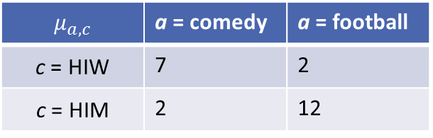
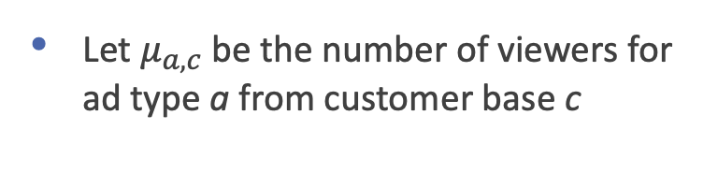

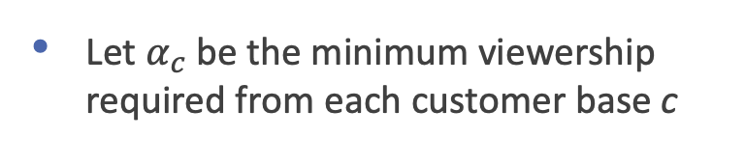
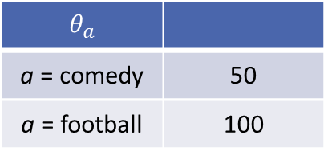
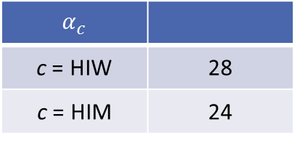
Organizing information – parameters
Let $θ_{a}$ is the cost of ad type a
$$θ_{a}$$
a = comedy | 50
a = football | 100
Let $α_{c}$ be the minimum viewership required from each customer base c
$$α_{c}$$
c = HIW | 28
c = HIM | 24
Let $μ_{a,c}$ be the number of viewers for ad type a from customer base c
$$μ_{a,c}$$ | a = comedy | a = football
c = HIW | 7 | 2
c = HIM | 2 | 12

Slide 21
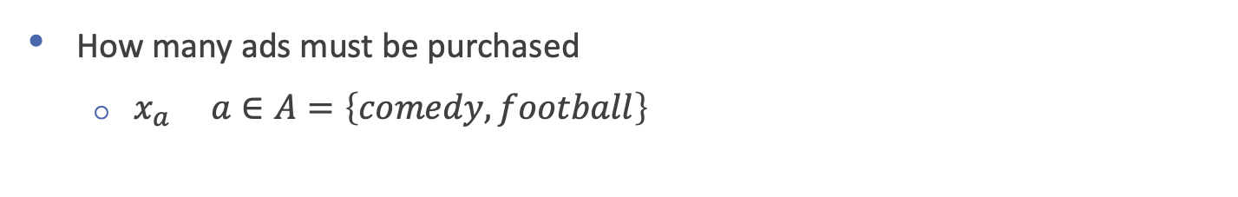
Organizing information - variables
How many ads must be purchased
$x_{a} a∈A=\left\{comedy, football\right\}$

Slide 22
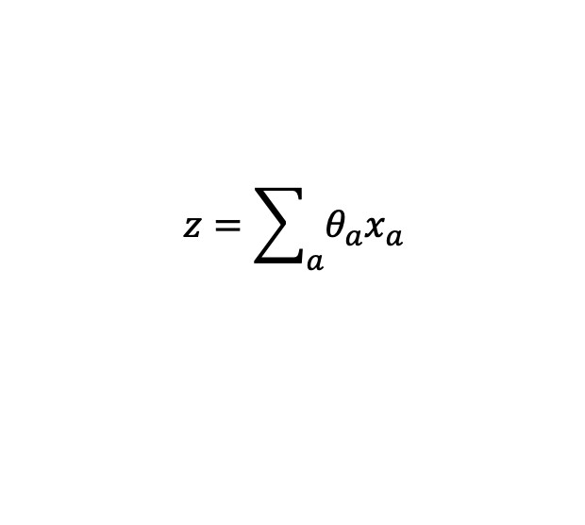

Organizing information: objective
Minimize: total advertising cost (in thousands of dollars)
Total advertising cost = cost of comedy ads + cost of football ads
= $\sum_{a}{θ_{a}x_{a}}$
Objective function:
$$z=\sum_{a}{θ_{a}x_{a}}$$

Slide 23
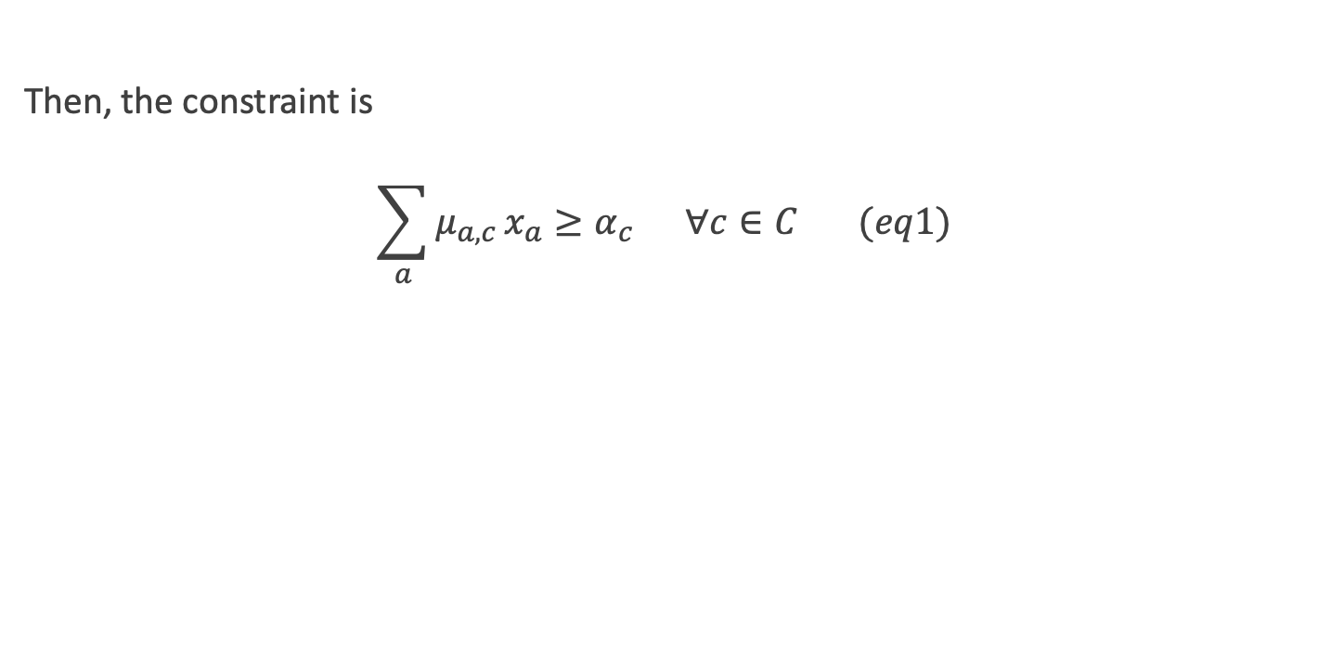
Organizing information: constraints
Then, the constraint is
$$\sum_{a}{μ_{a,c}}x_{a}≥α_{c} ∀c∈C (eq1)$$

Slide 24
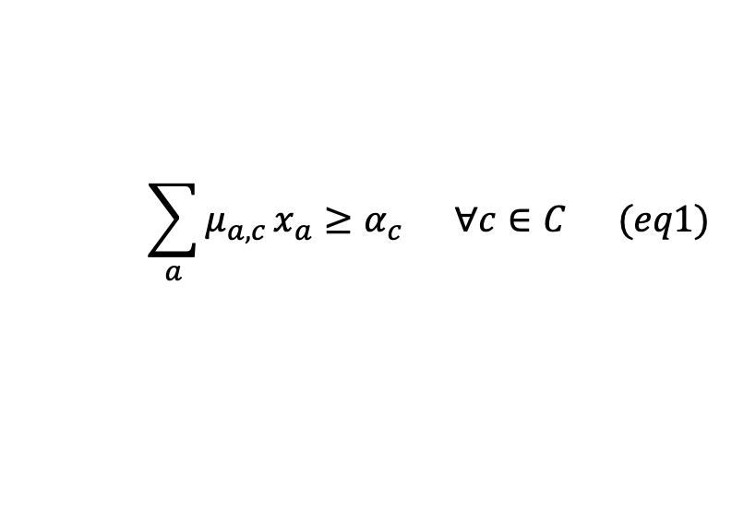
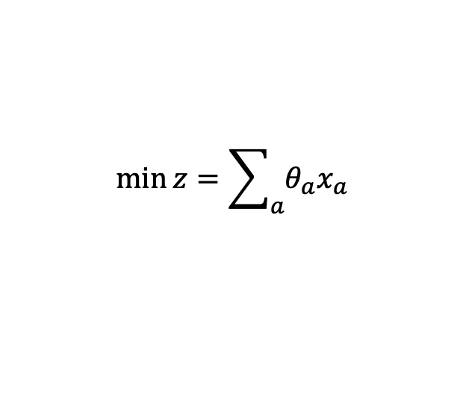
Assembling optimization model
$$\min{z}=\sum_{a}{θ_{a}x_{a}}$$
subject to
$$\sum_{a}{μ_{a,c}}x_{a}≥α_{c} ∀c∈C (eq1)$$
We did not use set I anywhere in the model!
Not all sets are used to build the optimization model

Slide 25
Summary
In this video, we learnt
The general structure of an optimization problem
Extracting, and organizing information from problem statement
Assembling an optimization model
Set definitions to make the model compact
Introduction to coding simple LP models in GAMS and Pyomo

